Slide 1

Option 2 – AirBnB Dataset Tableau Project
Prepared by: Chloe Phuong

Slide 2
Project Objective
My overall objectives of this project are:
Identify trends and patterns in pricing across different neighborhoods and property types.
Forecast the number of new hosts over time to anticipate market growth.
Cluster property types based on pricing to gain insights into market segments.
Visualize the density and distribution of records to identify areas of high activity.
Explore the distribution of beds across room types to understand accommodation preferences.
Finally, create a dashboard to present the analyzed data and visualizations in a clear and concise manner.

Slide 3
Process
Step 1: Data import
Step 2: Created the following visualizations
Line chart showing the average price for each neighborhood over time
Line chart with forecasting to predict the number of new hosts over time
Clustering visualization to analyze the average price based on property types
Heatmap to visualize the number of records
Pie chart showing the percentage of number of beds based on room
Step 3: Created a dashboard that combines all the above charts
The dashboard provides a comprehensive view of the data, allowing for easy comparison and analysis of different aspects of the Airbnb listings in NYC.

Slide 4
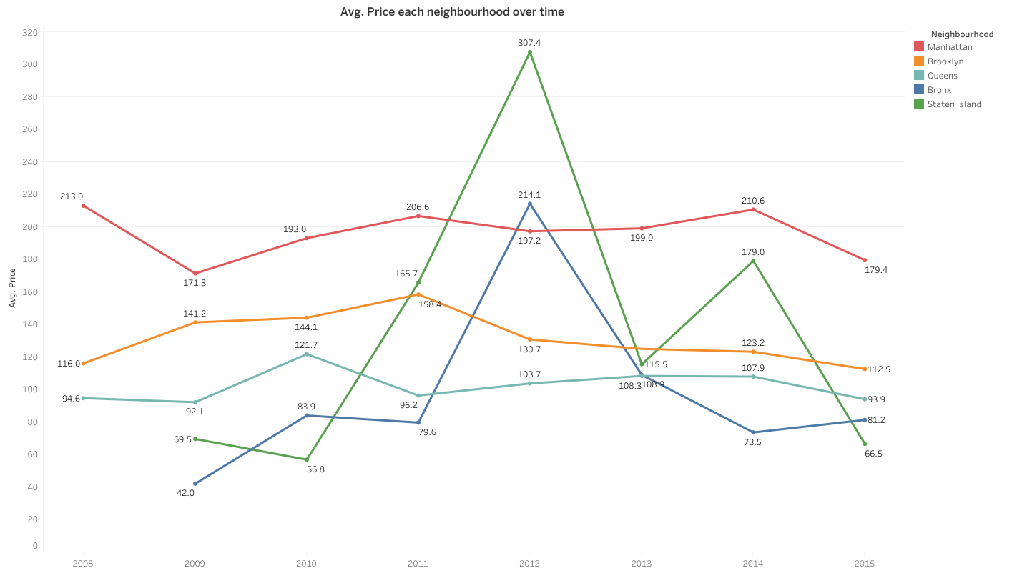
- How does the average price vary across different neighborhoods in NYC?

Slide 5
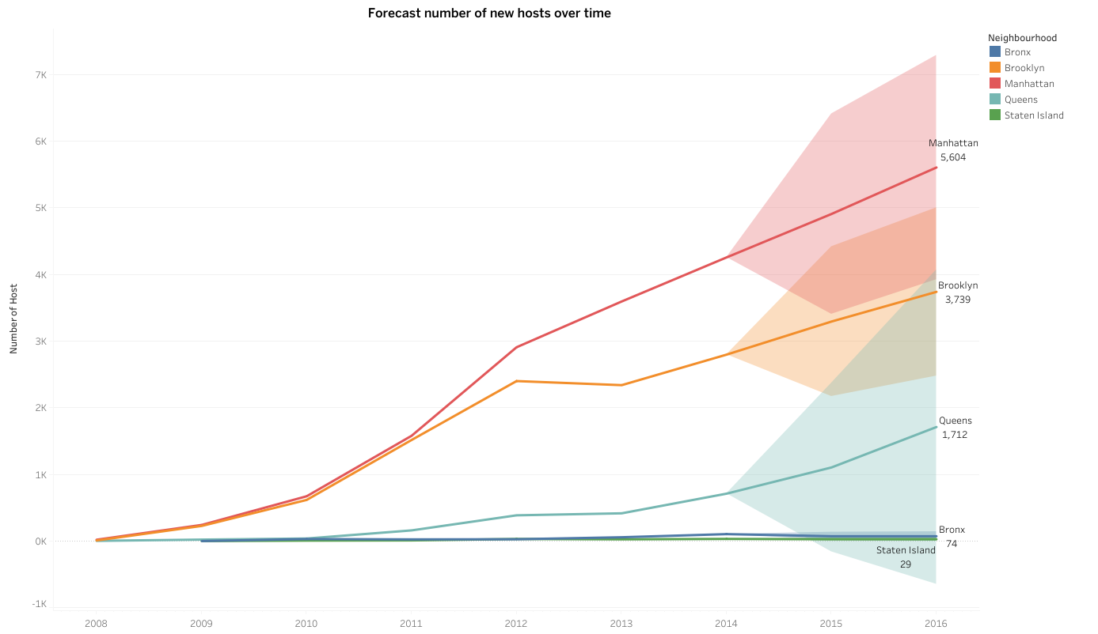
- What are the projected future trends for the number of new hosts?

Slide 6
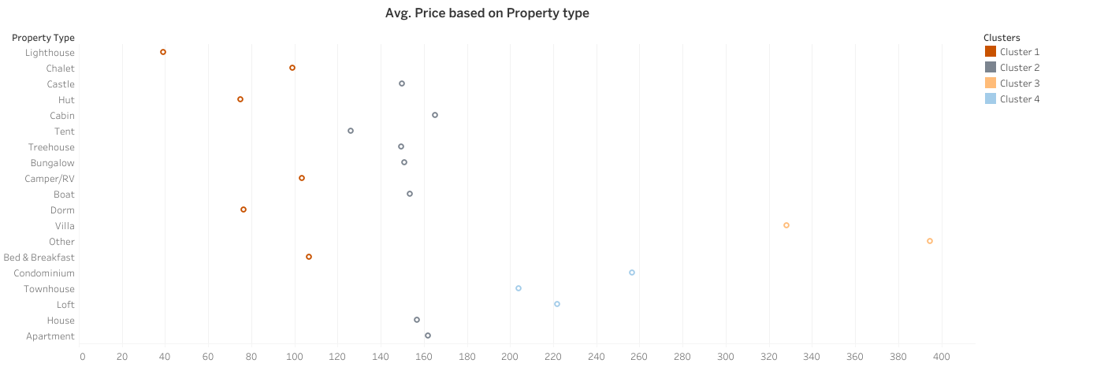
- How do the average prices differ among different property types?

Slide 7
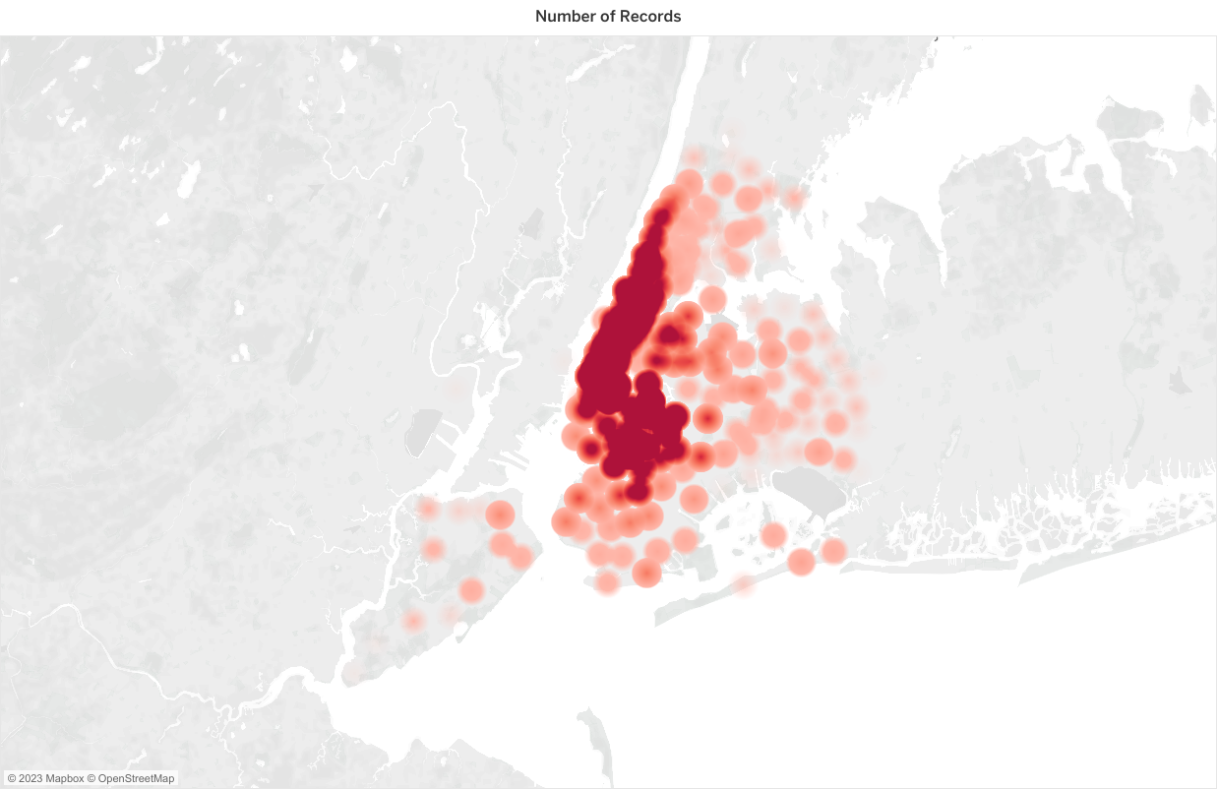
- Where are the areas or categories with the highest concentration of records in the dataset?

Slide 8
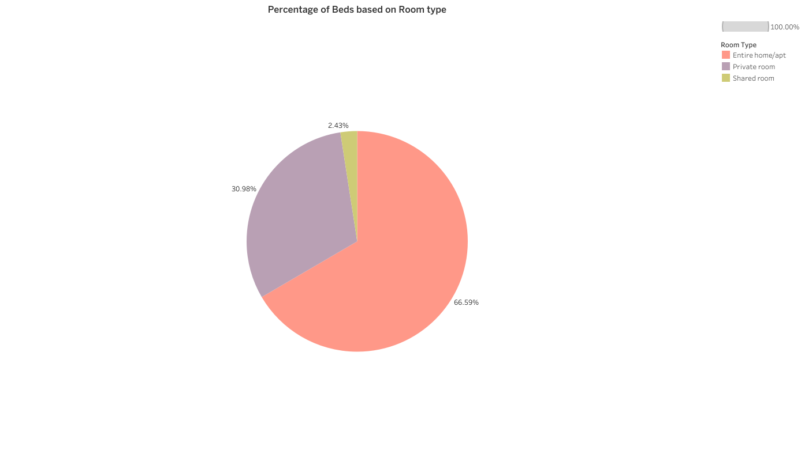
- How does the distribution of percentage of beds vary across different types of rooms?

Slide 9
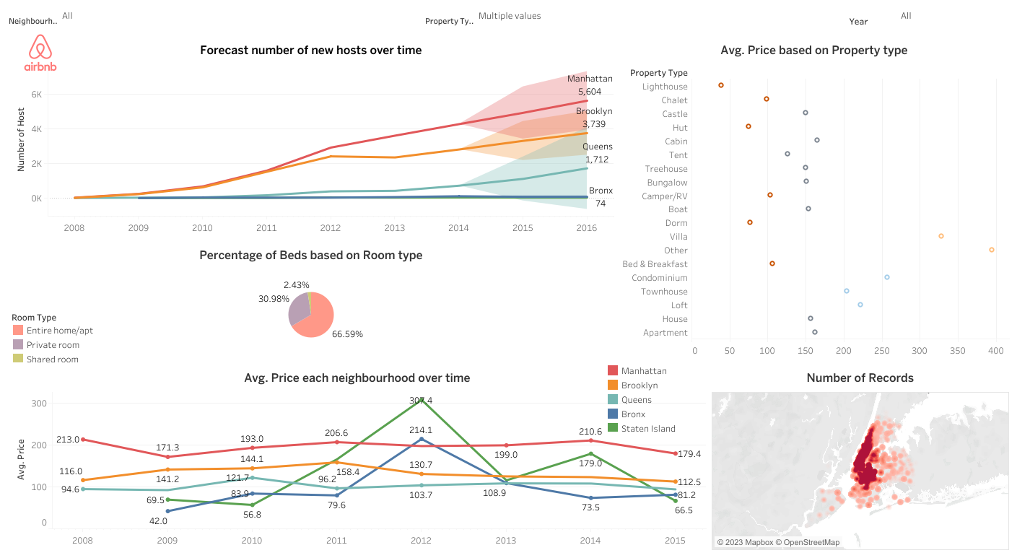

Slide 10
Challenges
Option 1: uncleaned dataset and difficulty to find common keys. Took me a lot of time to understand the questions
Quite time consuming to come up with ideas and choose suitable charts
If I had more time…
- creating more charts and conducting additional experiments to extract further insights from the data.
(And maybe I would like to continue to work on Option 1 to solve it)

